Slide 1

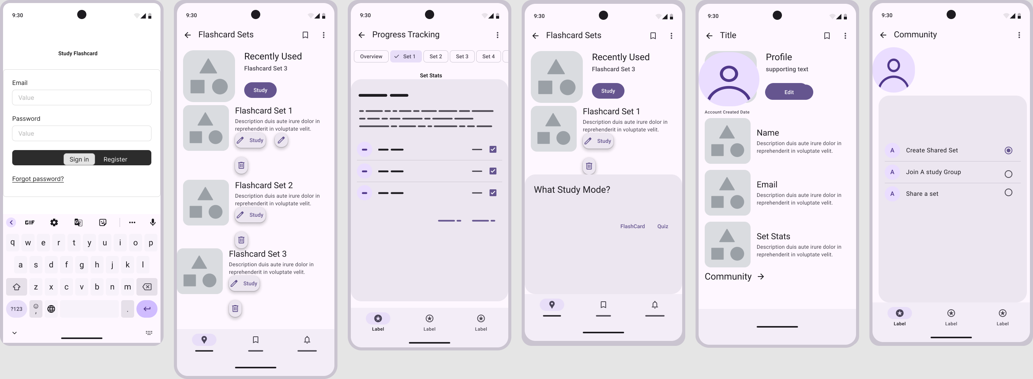

POP QUIZ PAL
Trinitee Jeffers, Chelsea Lowery, Ashari Joiner
Concepts of Advanced Application Development
INTRODUCTION
WIREFRAMES
CONCLUSION
Pop Quiz Pal is an interactive application that allows users to study efficiently by creating, organizing, and editing flashcard sets. The app offers features like repetition, timed flashcards, and user profiles. Users can track their learning progress and use editing features to quickly add new flashcards. The variety of features to learn make this a valuable platform for students, professionals, and lifelong learners.
Currently, the app focuses on creating, organizing, and studying flashcards. Further expansion could include gamification elements like the ability to join communities, leaderboards, in-app challenges, or integration with school curriculums or online courses for better learning outcomes. Throughout this project, we learned how to connect backend and front-end elements and how to identify, troubleshoot, and resolve errors. We significantly improved our problem-solving skills and gained a further understanding of the development process.
One of the main difficulties was ensuring the smooth integration between Firebase, Spring boot, and ReactJS. The asynchronous nature of the API calls led to some challenges with rendering data before it was fully fetched.
Another challenge was ensuring that the logout button only appeared after the user logged in and ensuring proper routing to and from the login page after logging in or out.
Ensuring that the app’s state is handled properly when switching between pages (using React’s state and routing) also required a lot of attention.
Another issue we had was with the search feature. Implementing it the way we wanted it to be completed was challenging.
TECHNOLOGY
Hardware
Personal Computers ( Development Machines)
Software
Development Environment:
IntelliJ IDEA (with Spring Boot)
Postman (API Testing)
Backend Frameworks:
Spring Boot
Google Firebase SDK
Frontend Frameworks:
React.js
HTML
Version Control:
Git and GitHub
APIs
Google Firebase (Authentication, Firestore Database)
Custom REST APIs developed with Spring Boot
Free Dictionary API
PPROCESS
The application design followed a structured and iterative process:
Database Creation: Designed the Firestore database with three primary collections: Flashcard Set, Flashcard, and User. Each collection was prefilled with 20 entries and is structured to support efficient data storage and retrieval for functionality.
Development Setup: Configured development environment using IntelliJ IDEA with Spring Boot and Java, Lombok, and Spring Web. This provided a robust platform for backend development.
Database Integration: Connected Firestore to the Sprint Boot application, ensuring seamless interactions between the backend services and the database.
Model Development: Created models for the data collections: User and Flashcard. These models are the foundation for managing data within the application.
Service and API Development: Developed the User service and Flashcard Service along with the REST APIs to handle business logic and enable communication between application and database
API Testing: Validated the functionality of the APIs using Postman, identifying and resolving issues to ensure reliable performance.
Front-End Integration: Incorporated React.js with HTML to support front-end functionality, enabling the application to present data dynamically to users.
CONTACT
Trinitee: trinitee1.Jeffers@famu.edu
Chelsea: chelsea1.lowery@famu.edu
Ashari:ashari1.joiner@famu.edu

